Slide 1
Analog sensor Interfacing
Arduino

Slide 2
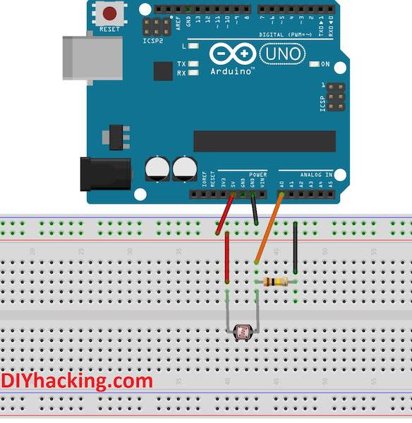
Arduino LDR Sensor Connections

Slide 3
Code:
int sensorPin = A0; // select the input pin for ldr int sensorValue = 0; // variable to store the value coming from the sensor void setup() { Serial.begin(9600); //sets serial port for communication } void loop() { sensorValue = analogRead(sensorPin); // read the value from the sensor Serial.println(sensorValue); //prints the values coming from the sensor on the screen delay(100); }

Slide 4
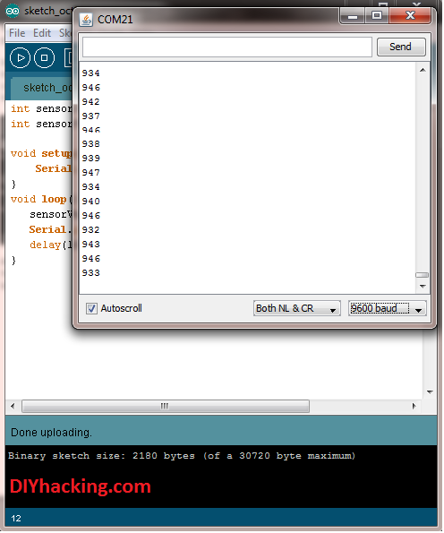
Sample Output:

